Slide 1
Life Insurance Solutions
Live. Learn. Thrive.

Slide 2
Focusing on what’s next in your life.
You are on the road to achieving financial success and there are many more goals you want to pursue. Preparing for a comfortable retirement. Paying for a child’s education. Leaving a legacy.
Whatever your goals, you’ll need to overcome real challenges. Market volatility. Low interest rates. Inflation. Outliving your assets. Tax uncertainty. And you’ll need a strategy that gives you every opportunity for financial success.
Fortunately, your financial professional and Life Insurance Solutions are on your side.

Slide 3
What’s new from Life Insurance Solutions could be what’s next for you.
Our life insurance products are engineered to efficiently solve for a defined need: protection or wealth accumulation.
Life insurance is best known for the financial protection it provides to individuals, families and businesses. But it can also help you achieve a wealth accumulation goal.
Insurance companies oftentimes promote policies designed to equally meet both protection and wealth accumulation goals. However, this approach creates inefficiencies. You may end up paying for features you don’t need.
At Life Insurance Solutions, we engineer our products differently to meet a specific goal in the most efficient way possible. Our life insurance policies start with a death benefit. Then, we design each product to focus on a defined need.
Life Insurance Solutions is designed to help you build wealth and generate the income streams you’ll need in retirement.

Slide 4
Life insurance spectrum and Life Insurance Soutions
Your Objective
Lifetime Protection Estate Planning
Life Insurance
Wealth Accumulation Income Generation
Life Insurance Solutions

Slide 5
Wealth. Income. Downside Protection.
Life Insurance Solutions is designed to help you accumulate wealth and generate streams of income, all with downside protection and exceptional tax- and cost-efficiency.
We offer:
Access to growth opportunities with protection against financial losses.
Tax- and cost-efficiency to enable you to keep more of what you earn.
Reliable downside protection, so you sleep better at night.
Flexibility, so you can respond to changes in financial markets or in your life

Slide 6
How Life Insurance Solutions works.
With Us you can:
Choose how to allocate your premium payments.
Access your cash surrender value, potentially tax-free, any time.
Pass on a death benefit to your beneficiaries

Slide 7
How Life Insurance Solutions works.

Slide 8
Efficiency. Reliability. Flexibility.
They are what Life Insurance Solutions is engineered to offer you in one product.

Slide 9
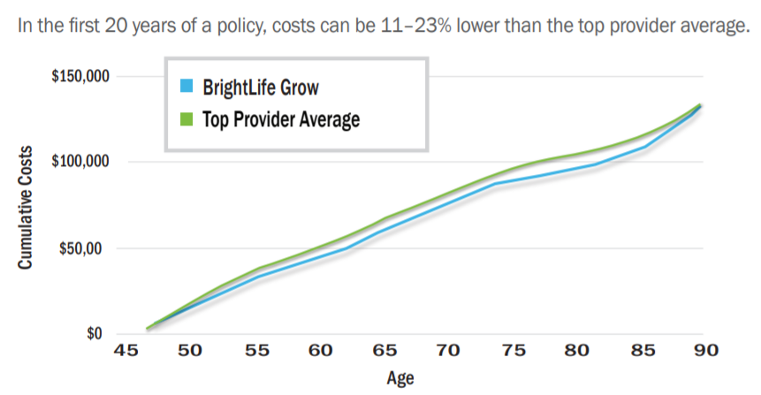
Efficiency. Reliability. Flexibility.
Efficiency begins with Life Insurance Solutions’ low cost structure and tax advantages.
Life Insurance Solutions is cost-efficient compared to its competitors
Life Insurance Solutions has a lower cost structure because you only pay for features that help you meet your wealth accumulation and retirement income goals.

Slide 10
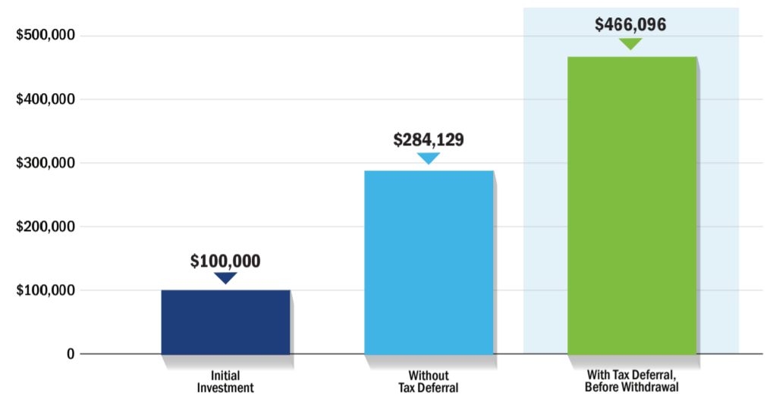
Life Insurance Solutions is highly tax-efficient
Your cash value grows tax-deferred, so you have the potential to increase your wealth more quickly. The example below shows how a hypothetical initial investment of $100,000 grows with and without tax deferral over a 20-year period.

Slide 11
Life Insurance Solutions is highly tax-efficient
Tax efficiency means more of your money goes to building:
A source of potentially tax-free income that’s always available to you through loans and other withdrawals against your cash value.
Assets to meet major life goals when the time comes or manage unexpected medical costs.

Slide 12
Reliability gives you peace of mind.
Life Insurance Solutions provides potential for upside (up to the cap) and protects you against loss during market declines.
Based on major indexes, you can earn up to a specified cap rate3 while the 0% floor ensures you’re always protected from negative returns. The Core Cap offers downside protection with a realistic cap. The Plus Cap offers the same downside protection but a higher cap for more aggressive upside potential at an additional charge.
Additionally, after a certain period of time, you may qualify for a segment bonus4 that adds more to your available assets.

Slide 13
Benefit from 0% downside protection

Slide 14
Flexibility means a robust range of options.
As your financial situation changes, Life Insurance Solutions’ flexibility allows you to:
Reduce payments, as long as there's enough cash surrender value in your policy to pay the monthly deductions.
Increase payments to potentially accumulate wealth more quickly.
Access your cash surrender value any time through potentially tax-free fixed loans and withdrawals.
Modify your death benefit at any time.
Change your premium allocation based on your comfort level with investment risk.

Slide 15
Allocating your premium
You can choose to allocate your premium based on market segment, equity index and upside index cap, and you can change these allocations at any time.

Slide 16
Potential tax-free income for a brighter retirement.
We can play a significant role in a well-designed retirement income strategy, particularly if you have maxed out on your 401(k) or 403(b) and your IRAs.
We can help supplement these popular retirement products:
Roth IRAs. These offer tax-free growth and withdrawal opportunities, but contributions are subject to income limits. If you've maximized your Roth, in addition to providing you life insurance protection, Life Insurance Solutions allows for virtually unlimited contributions, protection against market declines and access to tax-free loans and withdrawals at any age.
401(k)s and 403(b)s. These are tax-advantaged ways to save for retirement through your employer, but contributions are subject to annual dollar limits. We can provide an additional “bucket” of cash through tax- and penalty-free loans and withdrawals at any age.
With our participation in equity index-linked options, tax advantages and downside protection, you can feel better about your potential to generate retirement income that is often expected in fixed income investments, but may not have been met in recent years.

Slide 17
A larger legacy.
We provide death benefit so your loved ones will be financially secure if you were to die. And there is more:
Assets will pass income tax-free without probate and you control how assets will be distributed.
Beneficiaries are protected from business or other liabilities

Slide 18
Life Insurance Solutions benefits business owners.
With Us you can:
Help protect the business you lead and your stake in it.
Offset the impact of losing a key employee.
Enhance your company’s executive benefits or retirement plans.
Build up a reserve for unanticipated expenses or needs.
Fund a buy-sell agreement to ensure your family receives full fair-market value.

Slide 19
Tailor valuable options to your unique needs
To further customize your policy, you can add the following at issue:
Long-Term Care Services Rider. This rider allows you to get an "advance" on your life insurance benefits if you need to pay for qualified long-term care expenses. Any value you don't use will be paid to your beneficiaries at death.
Charitable Legacy Rider. At no cost, this rider allows you to designate a recognized charity to receive up to an additional 1% (or $100,000, whichever is less) of your policy’s base face amount without reducing your premium, cash value or death benefit.
Return of Premium Death Benefit Rider. For an additional cost, this rider enables your beneficiaries to receive an additional death benefit equal to a percentage of the premiums paid.

Slide 20
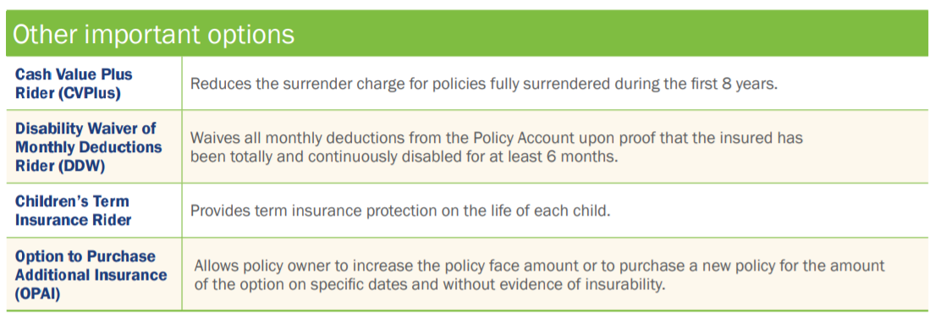
Tailor valuable options to your unique needs

