Slide 1
DEMYSTIFYING LIFE INSURANCE WITH LIVING BENEFITS
Helping clients to breathe easier

Slide 2
IN 2018
Approximately 21M students attended college¹
Approximately 2M people were married²
Some 5M homes were sold and over 400k new homes were built³
Over 500k small businesses were started⁴
There were approximately 4M births⁵

Slide 3
LIFE HAPPENS
Average annual cost of semi-private room in a nursing home is over $77,000¹
1/2 men & 1/3 women will develop cancer in their lifetime³
Strokes are a leading cause of disability; in the US someone has a stroke every 40 seconds²

Slide 4
ACCELERATED BENEFITS RIDERS (ABR’S)
Terminal Illness
Chronic Illness
Critical Illness
Critical Injury
Riders are supplemental benefits that can be added to a life insurance policy and are not suitable unless the client has a need for life insurance

Slide 5
THINGS TO CONSIDER
1
Product availability
2
State availability
3
Table ratings
Accelerated Benefits riders are optional and may not be available in all states or on all products. Receipt of Accelerated Benefits reduce the Cash Value and Death Benefit otherwise payable under the policy, may result in a taxable event, and may effect your clients eligibility for public assistance programs. The use of one benefit may reduce or eliminate other policy and rider benefits.

Slide 6
TERMINAL ILLNESS
Diagnosed with a terminal illness expected to result in death within 24 months
No waiting period
Lump sum distribution (discounted from death benefit)
Funds can be used at the policyholder’s discretion
Maximum lifetime benefit payable under all ABR’s $1,500,000

Slide 7
CHRONIC ILLNESS
Unable to perform two of six Activities of Daily Living or cognitive impairment
ACTIVITIES OF DAILY LIVING
COGNITIVE IMPAIRMENT
Bathing
Continence
Dressing
Eating
Toileting
Transferring
Required substantial supervision to protect oneself from threats to health and safety due to severe cognitive impairment
Short term or long term memory impairment
Loss of orientation to people, places or time
Deductive or abstract reasoning impairment

Slide 8
CHRONIC ILLNESS
Chronic Illness is calculated as 2% of the discounted net death benefit each month or 24% annually (not to exceed the IRS annual per diem).
The rider needs to be in force for 2 Years in order to accelerate
Funds can be used at the policyholders discretion (with state exceptions)
Maximum lifetime benefit payable under all ABR’s is $1,500,000

Slide 9
CHRONIC ILLNESS
For New York:

Slide 10
CRITICAL ILLNESS
Unable to perform two of six Activities of Daily Living or cognitive impairment
QUALIFYING CONDITIONS
SEVERITY LEVELS
ALS (Lou Gehrig’s disease)
Blindness
Cancer
End Stage Renal Failure
Heart Attack
Major Organ Transplant
Stroke
Minor
Moderate
Severe
Life Threatening

Slide 11
BUT WAIT…THERES MORE!
CRITICAL ILLNESS
CRITICAL INJURY
EXISTING
NEW
Coma
Paralysis
Severe Burns
Traumatic Brain Injury
Blindness
Cancer
Diagnosis of ALS
End Stage Renal Failure
Heart Attack
Major Organ Transplant
Stroke
Aorta Graft Surgery
Aplastic Anemia
Cystic Fibrosis
Heart Valve Replacement
Motor Neuron disease
Sudden Cardiac Arrest

Slide 12
CRITICAL INJURY
QUALIFYING CONDITIONS
SEVERITY LEVELS
WAITING PERIOD
Coma
Paralysis
Severe Burns
Traumatic Brain Injury
Minor
Moderate
Severe
Life Threatening
30 days
Maximum lifetime benefit is $1,000,000

Slide 13
CRITICAL INJURY
QUALIFYING CONDITIONS
SEVERITY LEVELS
WAITING PERIOD
Coma
Paralysis
Severe Burns
Traumatic Brain Injury
Minor
Moderate
Severe
Life Threatening
Was 90 now 30 days
Maximum lifetime benefit is $1,000,000

Slide 14
CRITICAL INJURY UNDERWRITING

Slide 15
DEMYSTIFYING DISCOUNTING
ABR Benefit is NOT equal to the face value of the policy.
Exercising ABR’s DOES reduce the death benefit received.
Exercising ABR’s DOES reduce the cash value received.

Slide 16
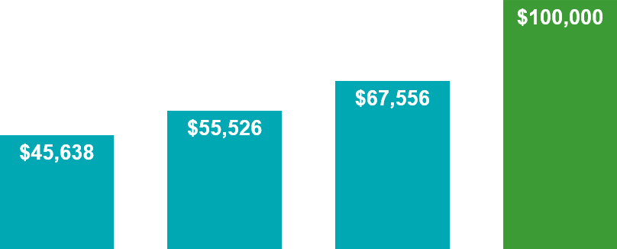
PRESENT VALUE OF $100,000 INTEREST RATE OF 4%
TODAY
10 YEARS
15 YEARS
20 YEARS

Slide 17
ILLUSTRATING THE IMPACT

Slide 18
SHOW ME THE MONEY
Present value of Death Benefit
- Present value of Remaining Premiums
- Claim process fee & Outstanding Loans
_______________________________
ABR BENEFIT

Slide 19
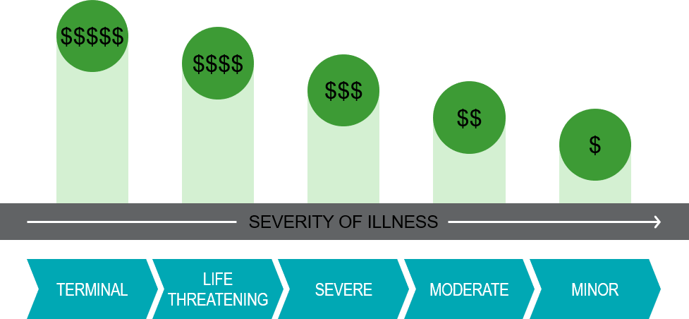
WHAT IMPACTS THE ABR BENEFIT?

Slide 20
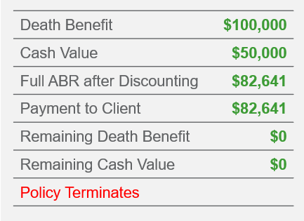
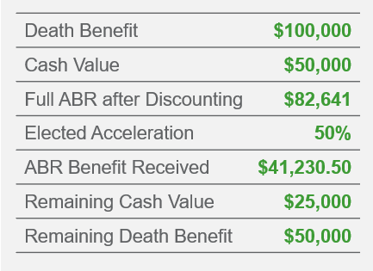
IS IT ALL OR NOTHING?
45 year old Male – Standard Non-Tobacco, FlexLife, Acceleration at age 65
Full Acceleration Lump Sum Payment Critical Illness or Critical Injury (Life Threatening category)
Partial Acceleration Lump Sum Payment Critical Illness or Critical Injury

Slide 21
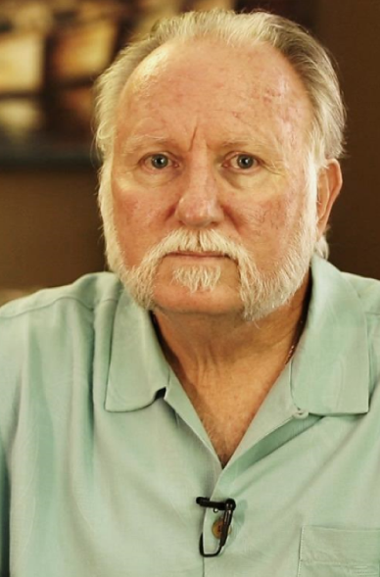
DOES IT REALLY WORK?
“It gave me options”
“The process needs to be talked about”
“I looked in my account at 6 a.m. and at 7 a.m. I gathered my things at work and said goodbye…this benefit enabled me to retire”

Slide 22
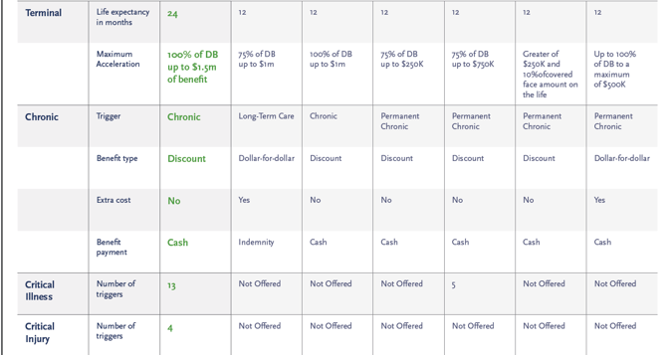
OFTEN IMITATED, NEVER DUPLICATED

Slide 23
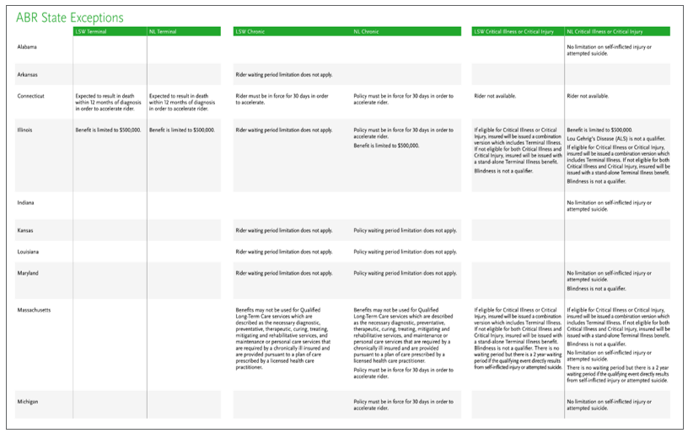
WANT TO SHARE AND LEARN MORE?

Slide 24
A QUICK LEVEL SET
Names of the current Accelerated Benefits Riders?
How much additional premium does a customer pay for these benefits?
Is additional underwriting required to receive them?
How does client qualify for ABR benefits?
What does ADL stand for?
What are the ADL’s?
What are the waiting periods?
What are the Maximum Lifetime benefits?

