Slide 1
College Funding

Slide 2
College Pricing Facts College Pricing Fact
The cost of college is rising 6 The cost of college is rising 6 ½ times as fast as the cost of times as fast as the cost of living.*
College costs are rising, while median household income is declining**
Public college costs are up 6.5% from last year and private colleges are up 4.4%.*
83% of students receive financial aid at private colleges.*
Private colleges spend on average $21,208 to educate each student.*

Slide 3
Questions to ask yourself Questions to ask yourself …
How do I position my financial situation to allow my child to attend the college of their choice?
How can I encourage my child to begin planning for college at an early age?
How can I ensure a quality education for my child?
How can I ensure a quality education for my child?
I have multiple children, how can I afford college tuition for all of them?

Slide 4
TUITION REWARDS TO THE RESCUE!
Earn Guaranteed Scholarships to Private Universities
Have Colleges Begin Recruiting Your Child as Early as Their Freshman Year in High School
Fund Multiple Children With One Plan
No Market Loss
Access to Funds Income Tax-Free

Slide 5
Why Life Insurance vs 529 Plan?
Let’s take a look at two of the most popular college funding vehicles used today, 529 Plans and the use of Life Insurance:
 | Life Insurance | 529 Plan
Annual Contribution Limit | No Limit | $13,000
Taxation of Withdrawals | Tax-Free, using loans | Tax-Free, qualified education expenses only
Value for State Education Financial Needs Analysis | Excluded | Included
Funding if Parent Dies (The Primary Source of Funding) | Death Benefit Completion, college funding | Stops, account value may not be sufficient

Slide 6
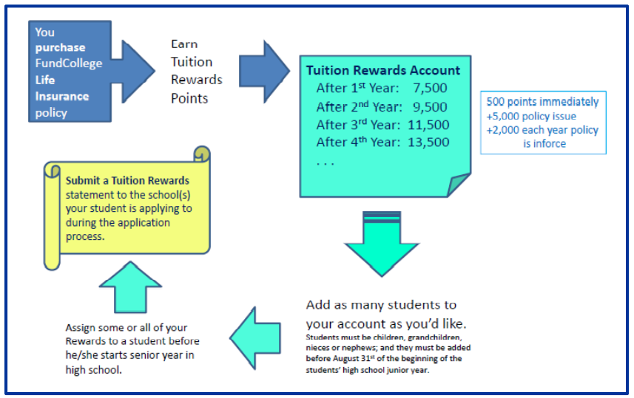
How it works:
You purchase life insurance policy

Slide 7
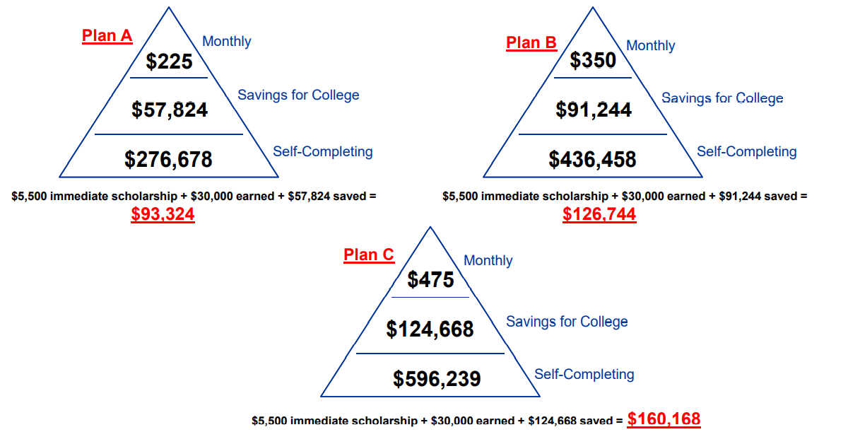
The POWER of Tuition Rewards

Slide 8
What Happens Next? What Happens Next?
Your College Funding Expert will enroll you into the Tuition Rewards Program.
Once enrollment is complete, you will receive a “Welcome Email” from the Tuition Rewards program. The email will provide instructions on how to activate your Tuitions Rewards account and receive your immediate 500 Tuition Rewards points.
Once your life insurance policy is placed in force, and you have activated your Tuition Rewards account online, you will be awarded with an additional 5,000 Tuition Rewards points.
You will continue to earn 2,000 points each year your life insurance policy remains in force.

